Slide 1
ML2, 2i
Controller / DataCORDER
Diagnosis
Any problems verified in this
presentation should be noted
on the returned controller

Slide 2
How To Verify Controller Alarms
PLEASE VERIFY THAT THE SOFTWARE AND CONFIGURATION #’s ARE CORRECT

Slide 3
How To Verify Controller Alarms
AL11 - Evap. Fan Motor #1 IP Open
24 vac at E1-A2 or S1-A2

Slide 4
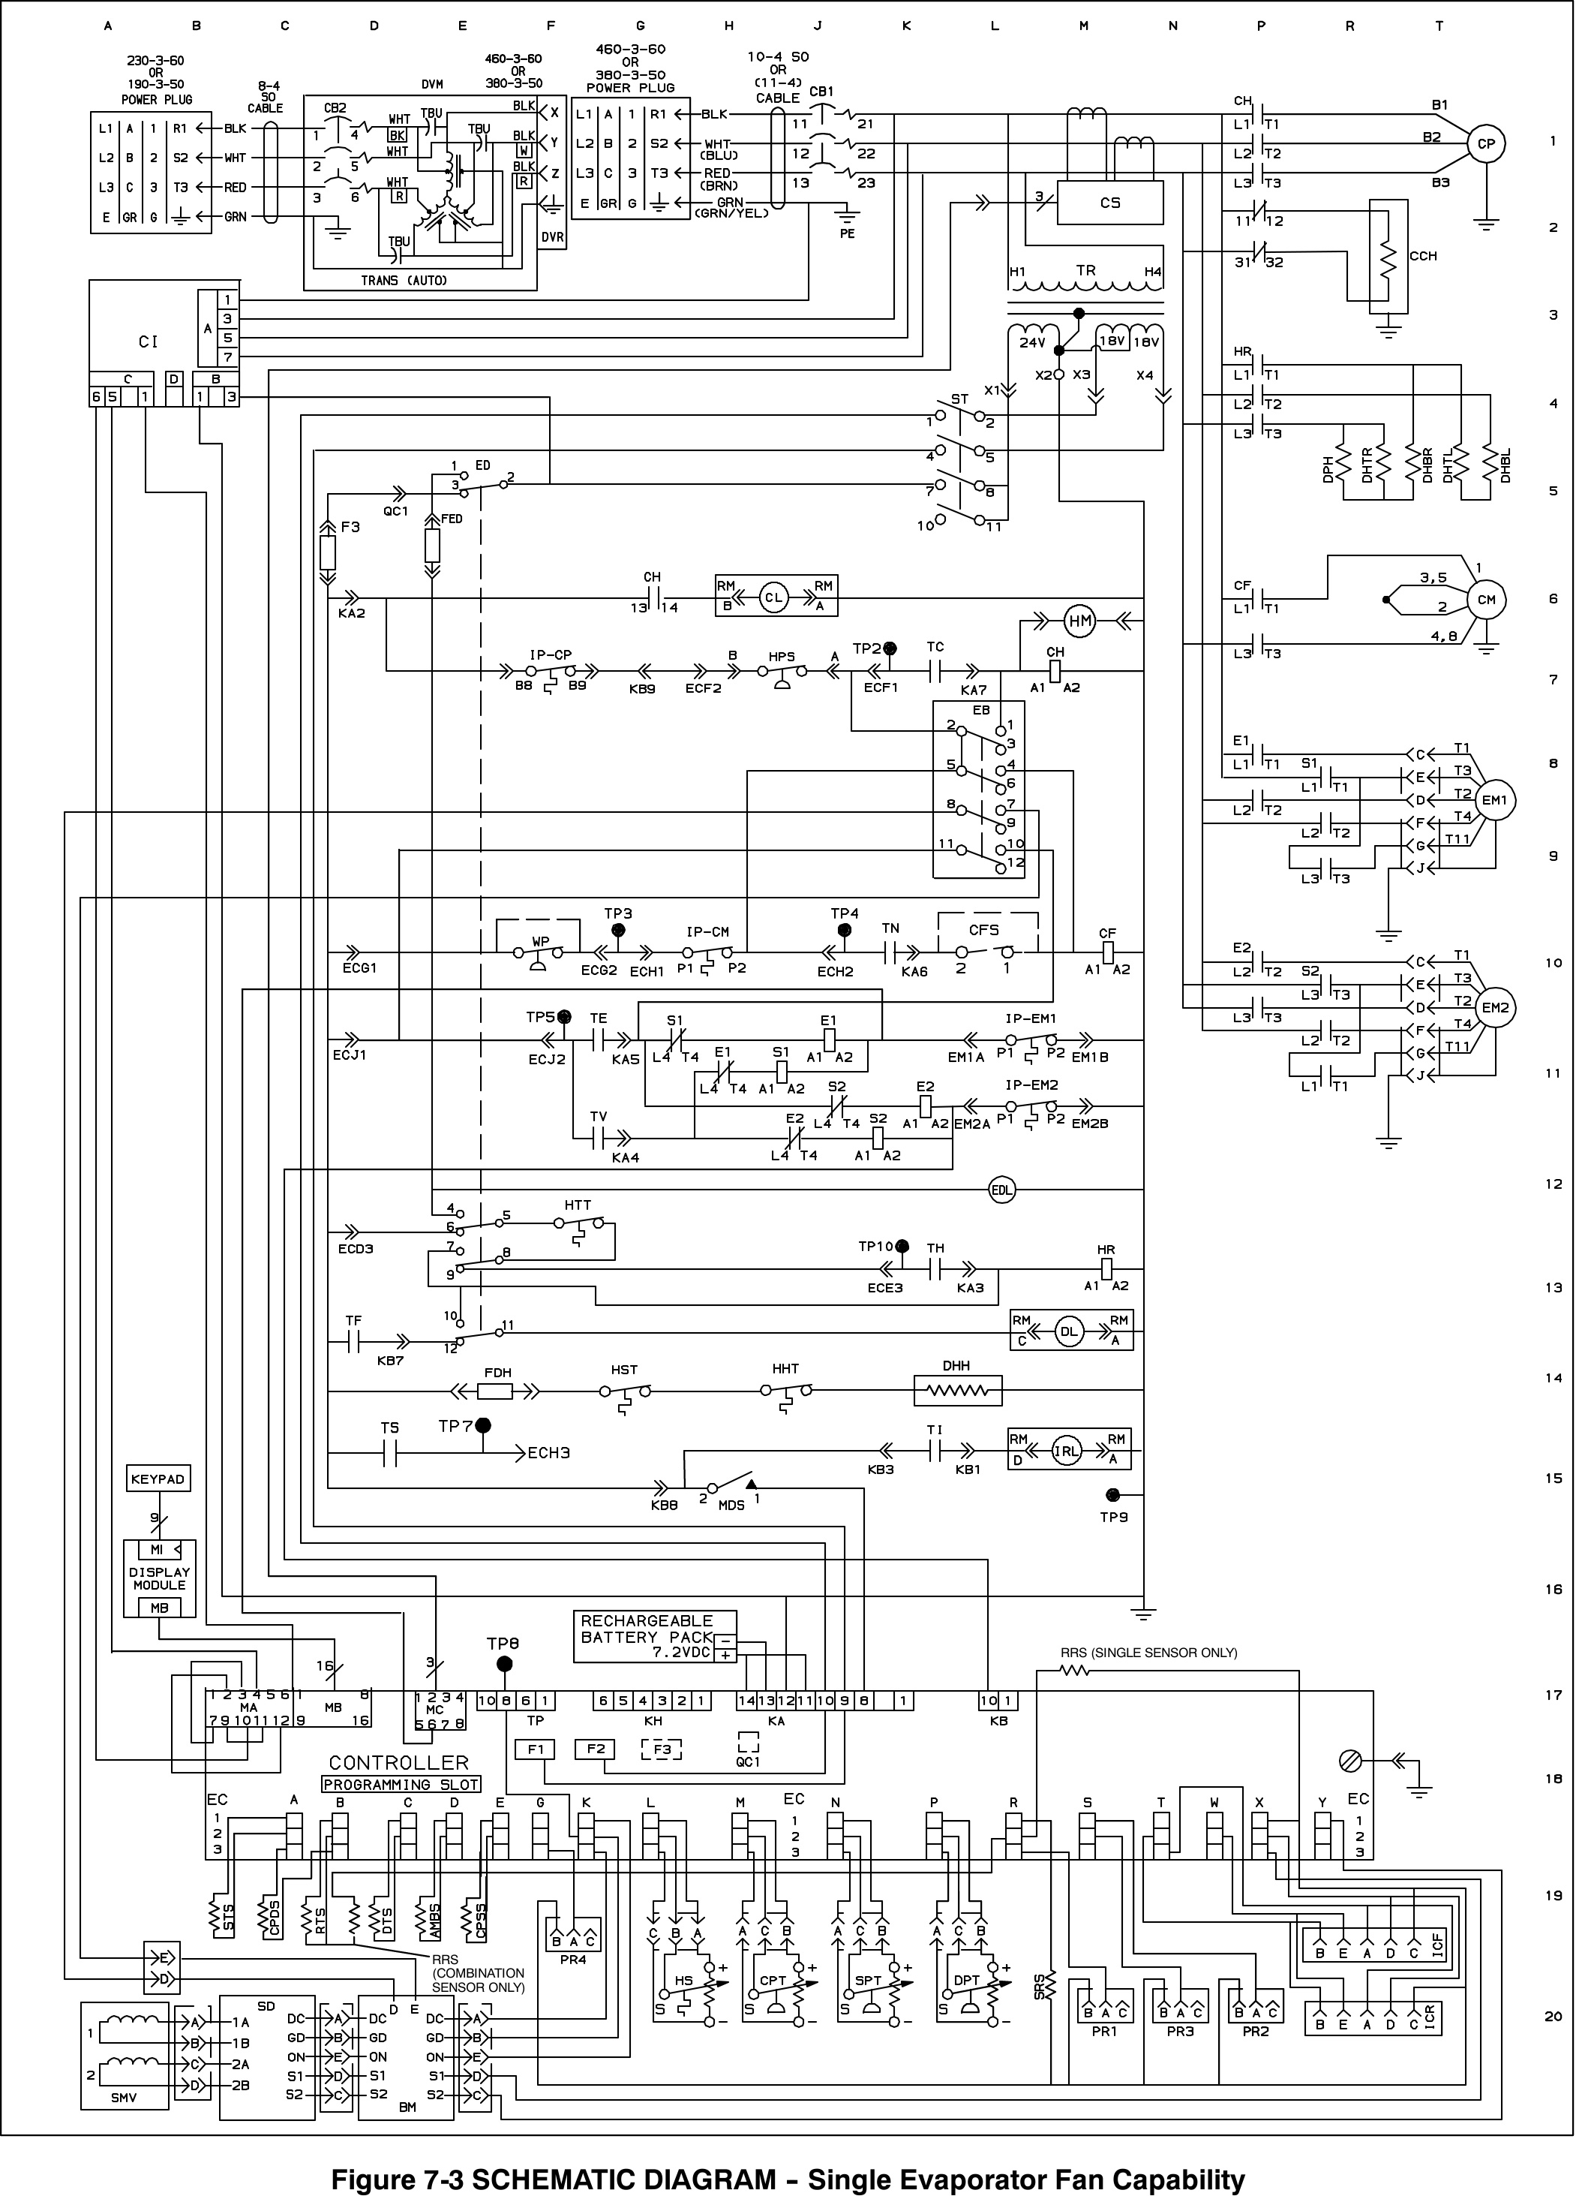
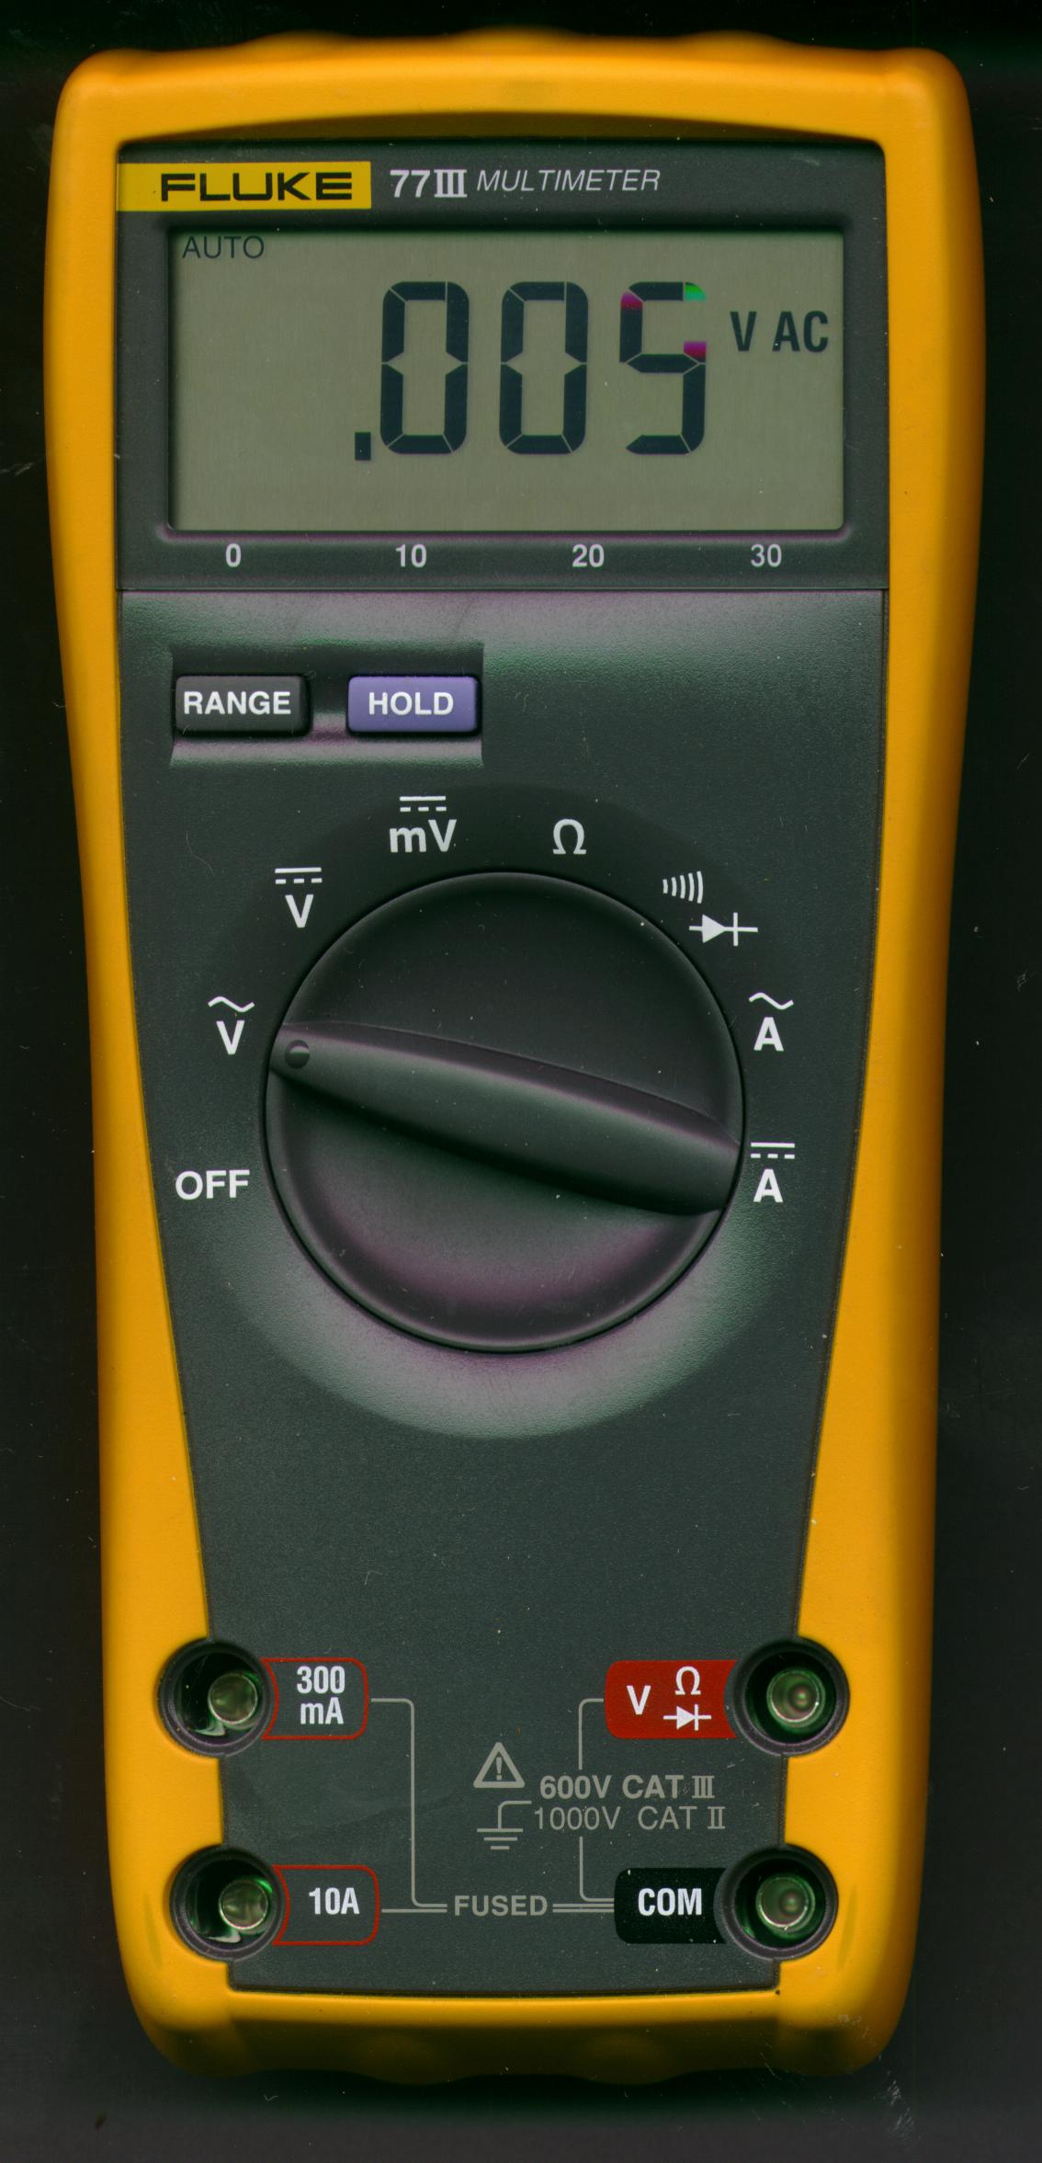
22.0
Vac

Slide 5
AL11
Evaporator Fan Motor #1 Safety
22.0
Vac

Slide 6
How To Verify Controller Alarms
AL11 - Evap. Fan Motor #1 IP Open
24 vac at E1-A2 or S1-A2
AL12 - Evap. Fan Motor #2 IP Open
24 vac at E2-A2 or S1-A2
AL20 - Control Circuit Fuse Open (24vac)
0 vac at KA2

Slide 7
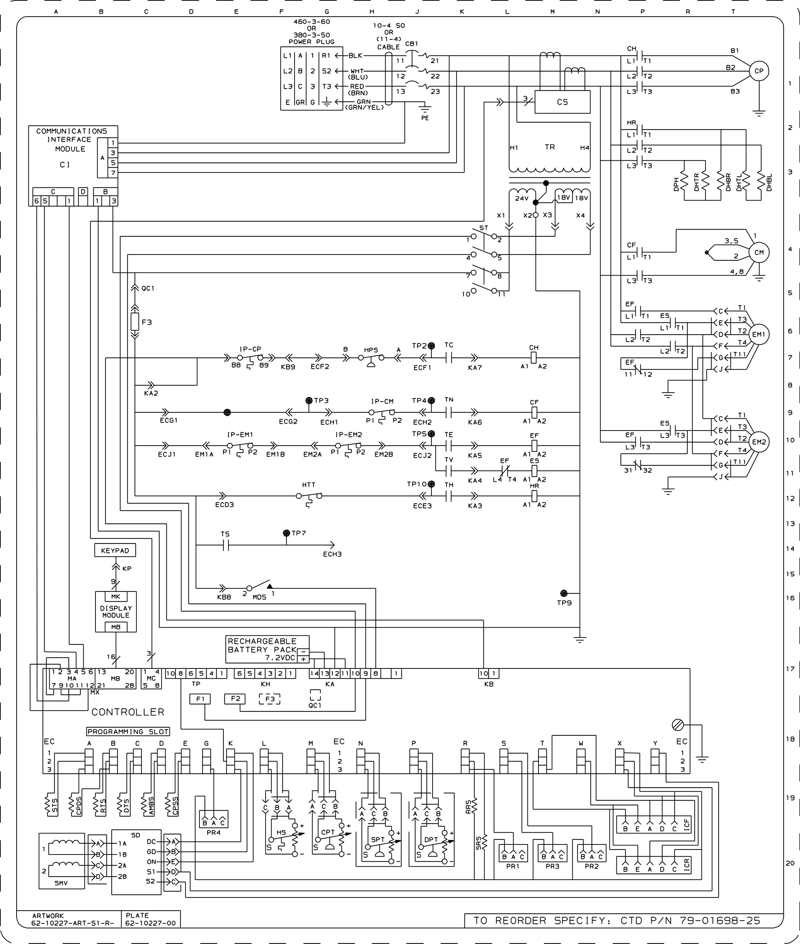
22.0
Vac

Slide 8
AL20
Control Circuit Fuse Open (24vac)
0.00
Vac

Slide 9
How To Verify Controller Alarms
AL11 - Evap. Fan Motor #1 IP Open
24 vac at E1-A2 or S1-A2
AL12 - Evap. Fan Motor #2 IP Open
24 vac at E2-A2 or S1-A2
AL20 - Control Circuit Fuse Open (24vac)
0 vac at KA2
AL21 - Control Circuit Fuse Open (18 vac)
0 vac at Output of F2 or F3

Slide 10
How To Verify Controller Alarms
AL22 - Evap. Fan Motor #1or #2 IP Open
0 vac at TP5 or Both AL 11 & 12 Active

Slide 11
22.0
Vac

Slide 12
AL22
Evaporator Fan Motor Safety
0.00
Vac

Slide 13
How To Verify Controller Alarms
AL22 - Evap. Fan Motor #1or #2 IP Open
0 vac at TP5 or Both AL 11 & 12 Active
AL23 - KA2 to KB10 is Open
0 Vac at KB10
AL24 - Compressor Motor IP Open
0 vac at KB9

Slide 14
22.0
Vac

Slide 15
AL24
Compressor Motor Safety
0.00
Vac

Slide 16
How To Verify Controller Alarms
AL25 - Condenser Motor IP Open
0 vac at TP4
AL26 - All Sensors Failure
Check Ω at EC Connections (refer to AL 54) & For Proper Seating of EC Connector
AL27 - Probe Circuit Calibration Failure
Micro Failure

Slide 17
How To Verify Controller Alarms
AL51 - Alarm List Failure
Check Software #, Update to 5119 or Higher, Replace Controller if Problem Happens Again
AL52 - Alarm List Full
Clear The List
AL53 - Battery Pack Failure
KA11, Should be 12-13vac with KA11-14 Jumper Disconnected

Slide 18
How To Verify Controller Alarms
AL54 - Supply Sensor Failure
Check Sensor Ω at ECA1-ECA2, Check Position of Probe

Slide 19
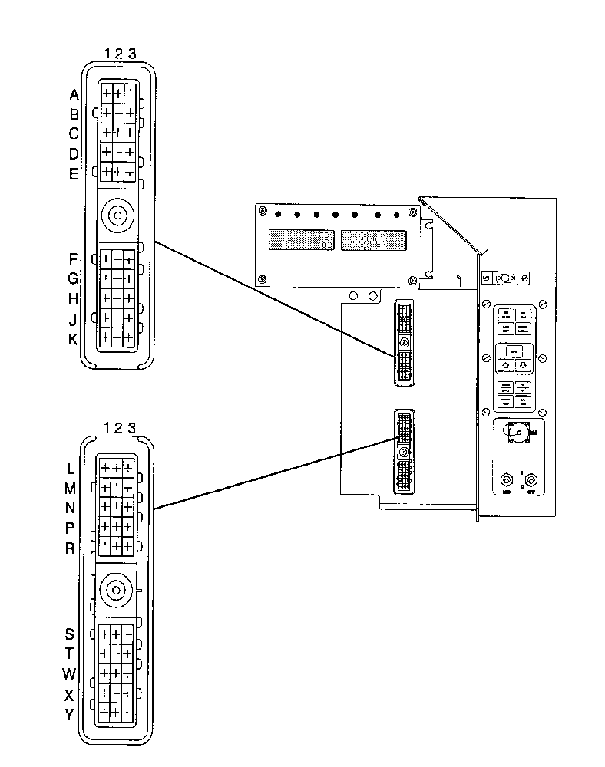
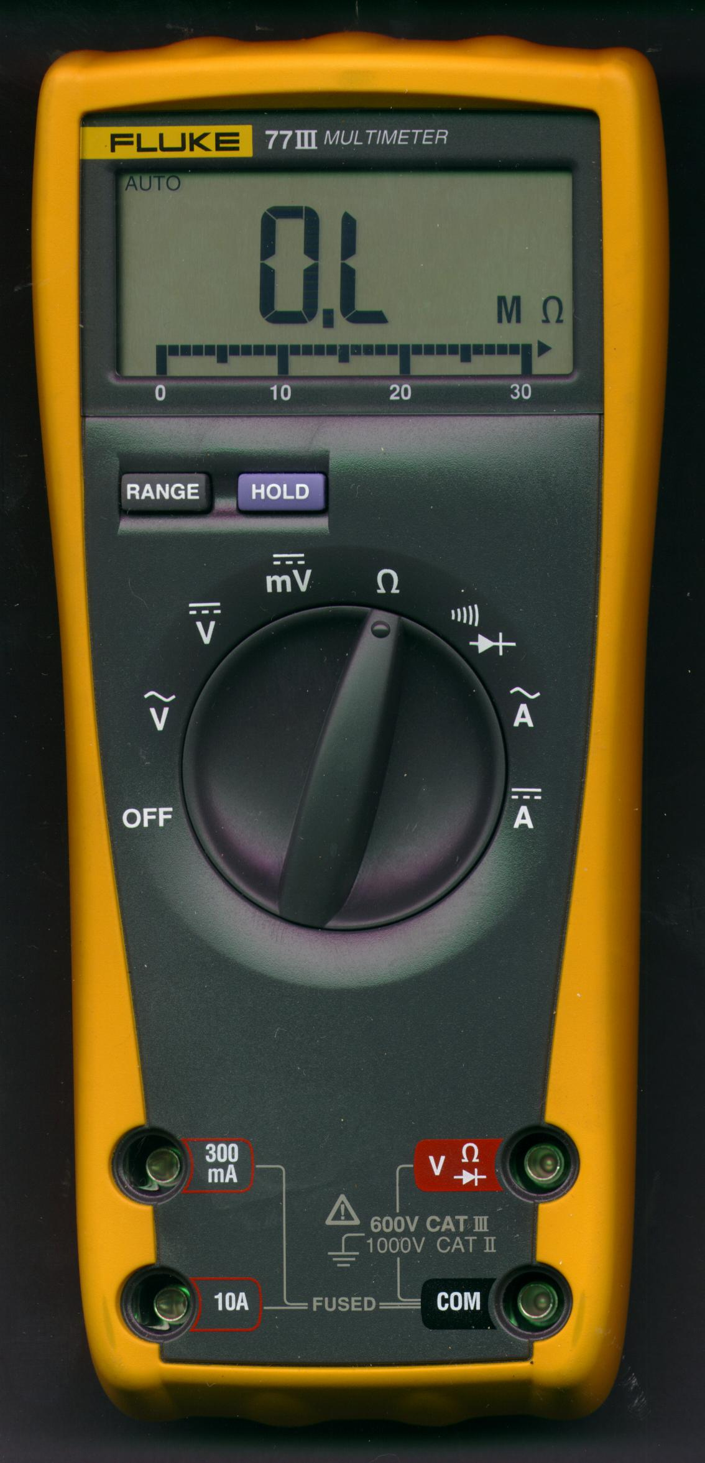
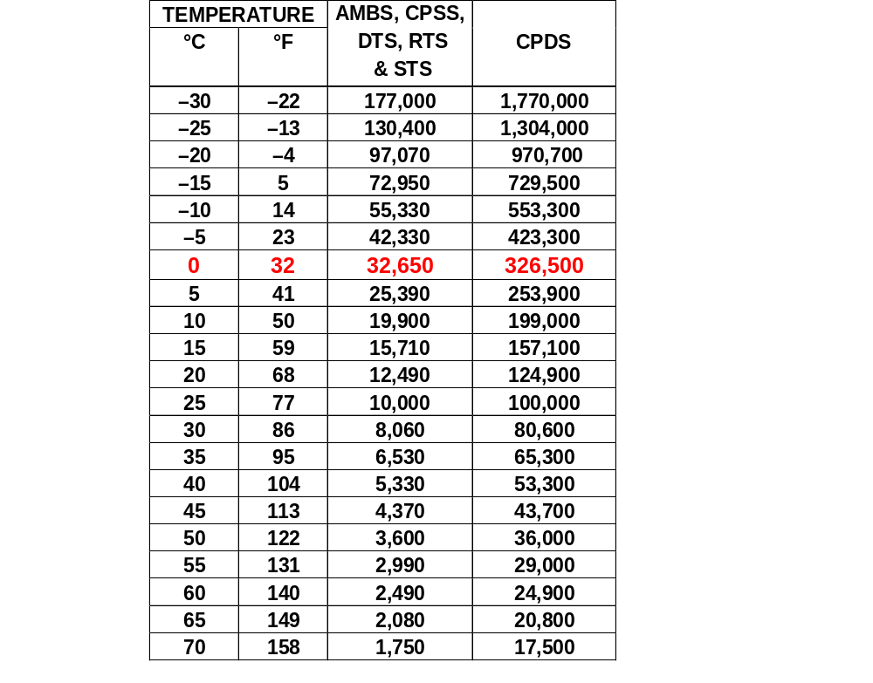
Thermistor Sensors
Temperature vs. Resistance
ECA1 - ECA2
(STS)
32,650Ω = 0ºC
(+/- .002%)
32,650
Use This Procedure For
Checking All Thermistor
Sensors

Slide 20
How To Verify Controller Alarms
AL55 - DataCORDER Failure
Load Latest Software # and Reconfigure
AL56 - Return Sensor Failure
Check Sensor Ω at ECB1-ECB2, Check Position of Probe (clearance from grill)
AL57 - Ambient Sensor Failure
Check Sensor Ω at ECD1-ECD2

Slide 21
How To Verify Controller Alarms
AL58 - Compressor High Pressure Safety
0 vac at TP2 for More Than One Minute

Slide 22
0.00
22.0
Vac
Vac

Slide 23
AL58
Compressor High Pressure Safety
(HPS)
26.0
0.00
Vac
Vac

Slide 24
How To Verify Controller Alarms
AL58 - Compressor High Pressure Safety
0 vac at TP2 for More Than One Minute
AL59 - Heat Termination Thermostat
0 vac at TP10
AL60 - Defrost Temperature Sensor Failure
HTT Open Within 2 Hours of Defrost or After 1/2 Hour of Compressor Run Time RTS is Below 7ºC With DTS not at or Below 10ºC

Slide 25
How To Verify Controller Alarms
AL61 - Heaters Failure
Improper Current Draw on Heaters Contactor
AL62 - Compressor Circuit Failure
Improper Current Draw on Compressor Contactor
AL63 - Current Over Limit
Unable to Maintain System Current Draw Below User Selected Value
(On Rail Car, Butt Splice Connections To Current Sensor)

Slide 26
How To Verify Controller Alarms
AL64 - Discharge Temperature Over Limit
Check Probe Ω at ECA3-ECB3
AL65 - Discharge Pressure Transducer Failure
Unplug Suction Pressure Transducer and Plug Into Discharge Pressure Transducer Harness
(Alarm should Disappear)

Slide 27
How To Verify Controller Alarms
AL66 - Suction Pressure Transducer Failure
Unplug Discharge Pressure Transducer and Plug Into Suction Pressure Transducer Harness
(Alarm should Disappear)
AL67 - Humidity Sensor Failure
Replace With A Known Good Sensor
AL68 - Condenser Pressure Transducer Failure
Replace With A Known Good Sensor (Alarm should Disappear)

Slide 28
How To Verify Controller Alarms
AL69 - Suction Temperature Sensor Failure
Check Probe Ω at ECE1-ECE2 Check Position of Probe

Slide 29
How To Verify Controller Alarms
ERR# - Internal Microprocessor Failures (0-5)
Change Controller
Lo - Low Main Voltage
Check vac Input To Control Transformer (less than 342 vac), Check Output At KA9 And KA10 (25% Low)
Entr Stpt - If SW # 5118 Or Higher
Re-enter Setpoint, If Problem Happens Again Change Controller

Slide 30
How To Verify DataCORDER Alarms
dAL70 - Recorder Supply Sensor (SRS) Failure
Check Probe Ω at ECR1-ECX1
Check Position of Probe
dAL71 - Recorder Return Sensor (RRS) Failure
Check Probe Ω at ECR2-ECX1
Check Position of Probe

Slide 31
How To Verify DataCORDER Alarms
dAL72-75 - USDA Probes Out of Range
Check USDA Probe Ω, Check For Proper Installation And Probe Configuration
dAL78-85 - Network Data Point (Network Sensors) Out of Range
Check Configuration # And Software #, Check DataCORDER Network Sensor Configuration using Dataview Program

Slide 32
How To Verify DataCORDER Alarms
dAL86 - Real Time Clock (RTC) Battery Low
Replace RTC Battery & Reset RTC Using Dataview Program, Upgrade to Software # 5115 or Higher
dAL87 - RTC Failure
Upgrade Software #, Reset RTC Using Dataview Program, Replace Controller If Problem Happens Again

Slide 33
How To Verify DataCORDER Alarms
dAL88 - DataCORDER EEPROM Failure
Upgrade Software #, Use Dataview - System Tools to Clear
dAL89 - Flash Memory Error
Upgrade Software #, Replace Controller If Problem Happens Again
dAL91 - Alarm List Full
Clear Alarm List and Upgrade to Latest Software #

